Slide 1
Decoding Cell Behavior in Bioreactors: Deep Learning & Latent Space Insights
DTU Biosustain

Slide 2
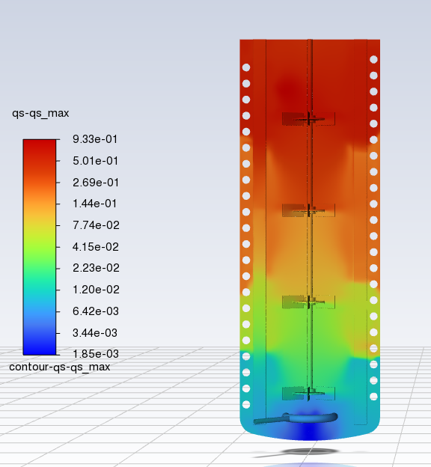
Introduction
Background:
Bioreactors are complex environments where cells undergo various metabolic states
Understanding cell behavior in bioreactors can optimize productivity and ensure stability
Objective:
Utilize deep learning and latent space analysis to decode cell behavior in bioreactors
Explore how to reduce dimensions of data (Genome-scale model)
Analyze similarities and trends within cell lifelines (e.g. cycles in reactor)
Analyze similarities and trends between cell lifelines / cluster of cells
Determine meaningful metabolic states and the reactions that define metabolic clusters
Notes:
Genome-scale model – ultimate reason for dimensionality reduction / latent space, Dfba constrain the proteome to fight back the assumption of steady state (next step) a cell cannot change infinitely fast

Slide 3
Introduction
Initial Testing / Analysis is with “textbook” E.Coli model in Cobra
CFD Simulations:
Key Equations:
Continuity Equation: Mass conservation
Navier-Stokes Equation: Fluid momentum
Mass Balance Equation: Concentration changes
Tracking Cell Lifelines:
Parcels assume fluid density and velocity
Visualize environmental factors affecting cells over time
dFBA Model:
Monod Kinetics: Describes substrate uptake
Lexicographic Optimization: Maximizes biomass and minimizes glucose uptake constraints
Simulation: Runs dFBA for each timestep, storing reaction fluxes and errors
Notes:
Dfba constrain the proteome to fight back the assumption of steady state (next step) a cell cannot change infinitely fast

Slide 4
Overview of Approach
Deep Learning:
Dimensionality reduction
Used LSTM-based autoencoders to model temporal data from bioreactors
Generated latent space representations for each cell lifeline
Latent Space Analysis:
Original Features -> Latent Space: Perturbation Analysis
Trial and Error: Metabolic states over time using UMAP and t-SNE embeddings -> KMeans clustering
What reactions are in each metabolic state: SHAP Feature Importance

Slide 5
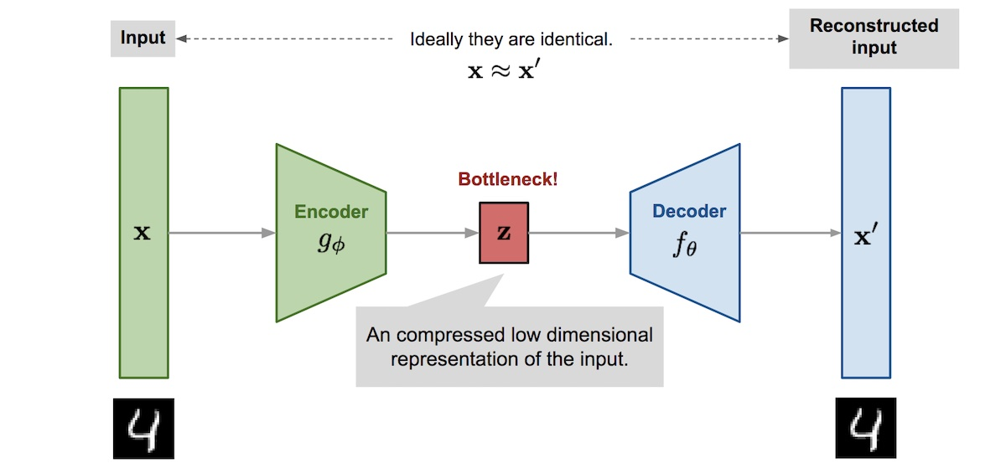
Autoencoder Architecture

Slide 6
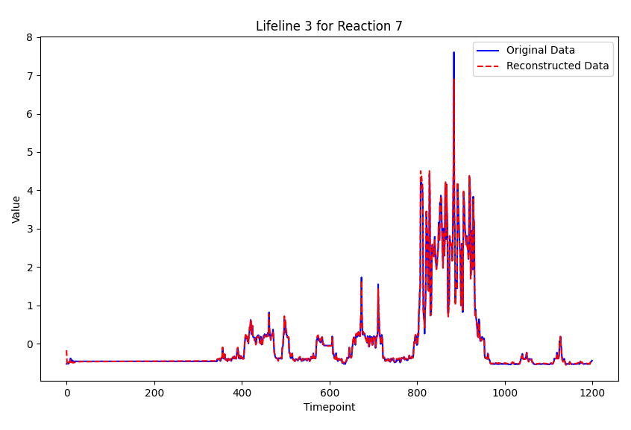
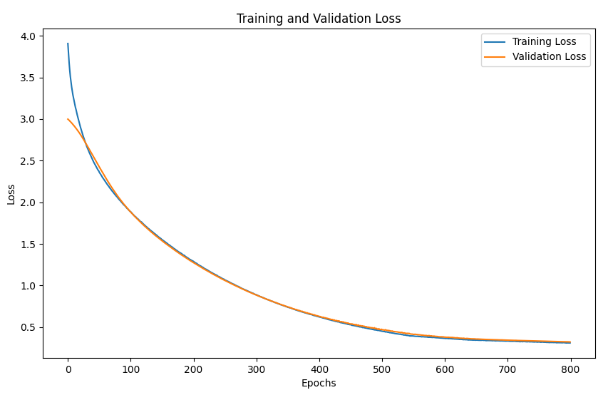
Autoencoder Architecture
Model Structure:
Input: Lifelines x Timesteps x Features
Encoder: LSTM layers with dropout for regularization
Latent Space: Dense layer representing compressed information
Decoder: Reconstructs the input from latent space
Training:
Loss function: Mean Squared Error (MSE) for reconstruction
OneCycleLRScheduler

Slide 7
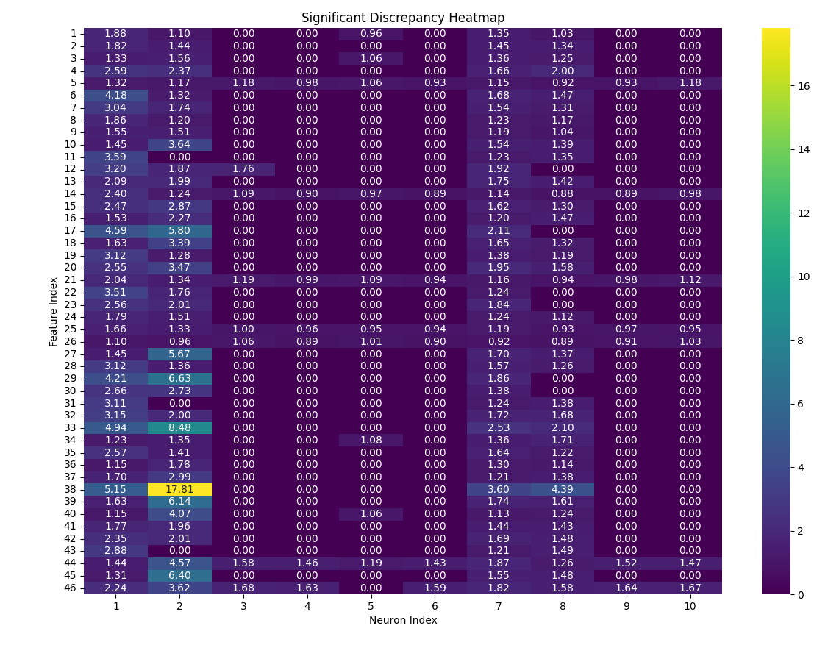
Latent Space: Perturbation Analysis
Why ? To determine relationship between original space and latent space
Latent Space Manipulation: Zeroed specific neurons to assess their impact on data reconstruction
Reconstruction and Comparison: Compared original data with reconstructed data to identify discrepancies
Discrepancy Analysis: Highlighted significant discrepancies, reaction 38 (PYK), 33 (PFK), 29 (NADTRHD)
Notes:
Check feature 38

Slide 8
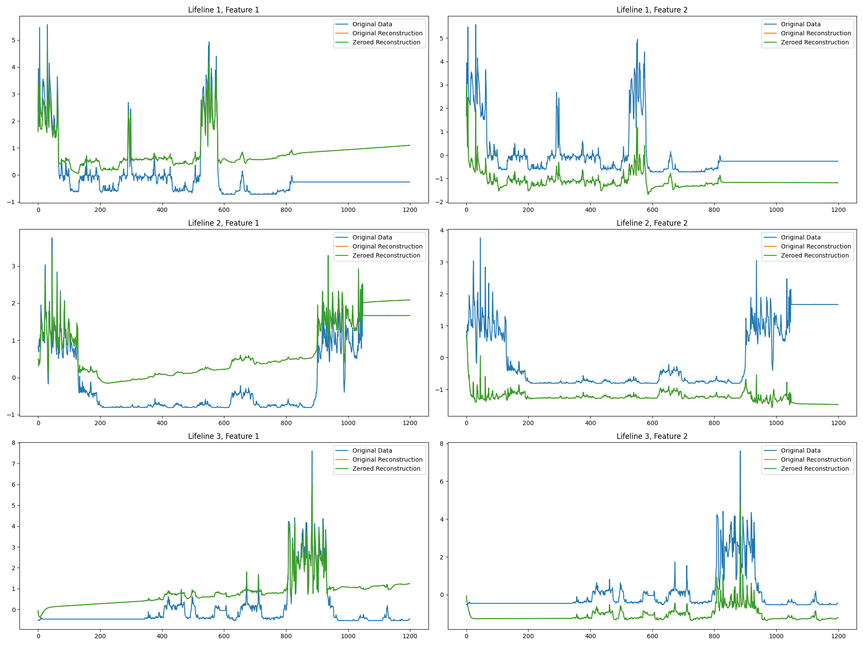
Latent Space: Perturbation Analysis

Slide 9
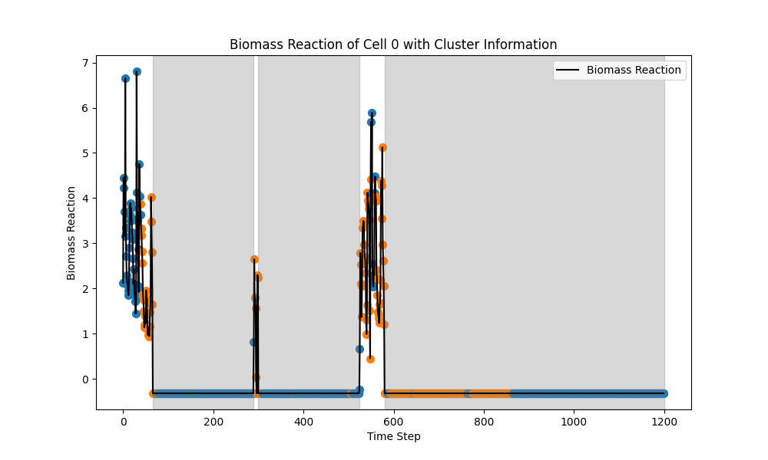
Clustering: Investigative Approach
Why ? To determine cluster of cells in same metabolic state (goal)
Embedding Techniques:
Created t-SNE embeddings for latent representations
Clustered cells at each timestep to identify similar groups
Visualization and Analysis:
Visualized biomass reaction with cluster information
Highlighted cell-specific clusters in dynamic plots
Notes:
States in the bioreactor relative to each timestep, still investigating problem

Slide 10
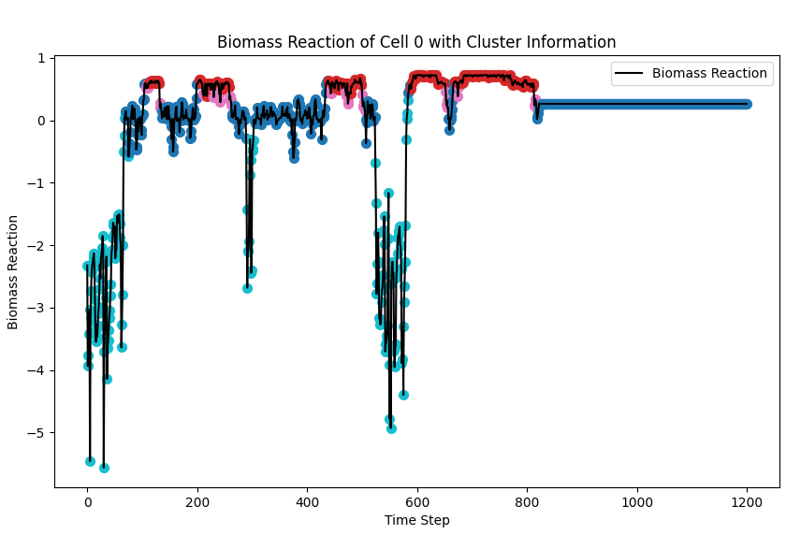
Clustering
Why ? To determine cluster of cells in same metabolic state (goal)
Embedding Techniques:
Created t-SNE embeddings for latent representations
Clustered cells all timesteps together => more indicative of clear groupings / states
Notes:
States in the bioreactor relative to each timestep, still investigating problem

Slide 11
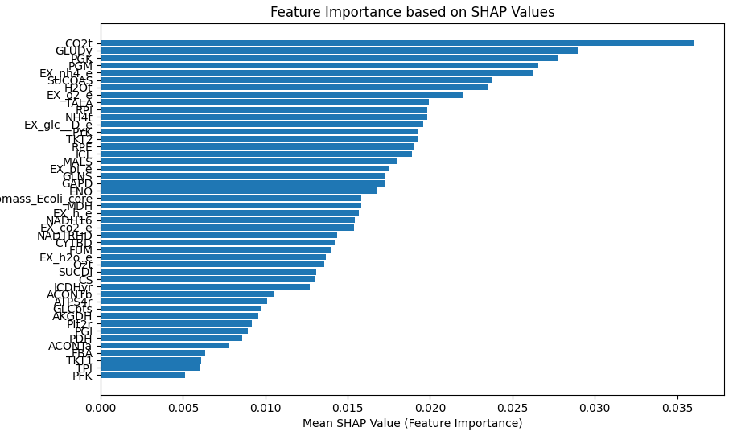
SHAP Feature Importance
Why ? To determine most important reactions and relate find out which reactions contribute to a metabolic state
SHAP Values Computation:
Used KernelExplainer to compute SHAP values for reconstruction errors
Top features: CO2t, GLUDy, PGK, PGM, Ex_nh4_e, SUCOAS, H2Ot
Notes:
Visualization:
Plotted feature importance based on mean SHAP values
Visualized reconstruction errors for each feature to identify key areas of impact

Slide 12
What’s Next
Analyze with biological context
More experiments
Perturbation Analysis on original features to see impact on metabolic states

Slide 13


